Slide 1
COMPARISION OF ALGORITHMS FOR HANDWRITTEN DIGITS RECOGNITION

Slide 2
Introduction
Compares the relative merits of Optical Character Recognizer and Neural Network based handwritten digit recognition system.
Digitizing handwritten texts so that they can be electronically edited, searched and stored more compactly.
The converted text files take less space than the original image file.
The problems faced are due to diverse text patterns and various background interferences.

Slide 3
Classification
Handwriting Recognition is classified into two types:
Off-line Recognition, deals with bitmap images from a camera and recognize the characters from the picture.
On-line Recognition, deals with x-y coordinates and try to recognize characters that are written on the smartphone.
In off-line systems, the neural networks have been successfully used to achieve comparably high recognition accuracy levels.

Slide 4
Optical Character Recogniser
Process of converting images the handwritten Numerical into computer format text.
High clarity image capture through TESSERACT-OCR technique.
Accuracy can be increased if the output is constrained by a lexicon (a list of words that are allowed to occur in a document).
Uses its dictionary to influence the character segmentation step.

Slide 5
Components of OCR
Optical Scanning
Location Segmentation
Input text
Pre-Processing
Segmentation
Training and Recognition
Feature Extraction
Output text
Post-Processing
Representation
Digitize analog document using an optical scanner.
Regions containing text are located and each symbol is extracted through segmentation.
These are pre-processed to eliminate noise to facilitate feature extraction.
Identity of each symbol is found by comparing extracted features with descriptions of symbol classes.
Contextual information is used to reconstruct words of the original text.

Slide 6
Implementing Real Time OCR and challenges
Results are highly dependent on font type of both the trained and tested characters.
Image processing on memory limited devices is difficult.
Limited clock speeds to process huge matrices.
Problematic if the document contains words not in the lexicon, like proper nouns.
Maintaining huge Bitmaps for pre-processing and sending to multiple threads.
Avoiding Garbage Collection of important preprocessed data.

Slide 7
Neural Network Based Recogniser
The problem of pattern recognition can be solved by using machine learning.
Ability to learn without being explicitly programmed.
We use supervised learning where a dataset is given and the correct output should look like as it is already known.
We take a large number of handwritten digits and then develop a system which can learn from those training examples to automatically infer rules for recognition.
Steps needed to detect handwritten digits:
Create database of handwritten digits.
For each digit extract HOG features and train a linear SVM.
Use the classifier trained to predict digits.

Slide 8
We use MNIST database of 70000 samples of handwritten digits.
Workflow of Training phase
Pre-process each image using Gaussian blur.
Extract the HOG feature of each image.
Make data file from feature vector and its label.
Create a model file from the data file using svm-train.
Workflow of Testing phase
Pre-process the input image using Gaussian blur.
Perform horizontal and vertical projection profile.
Extract the HOG features of each character.
Predict character using svm-predict against the model file created during training.

Slide 9
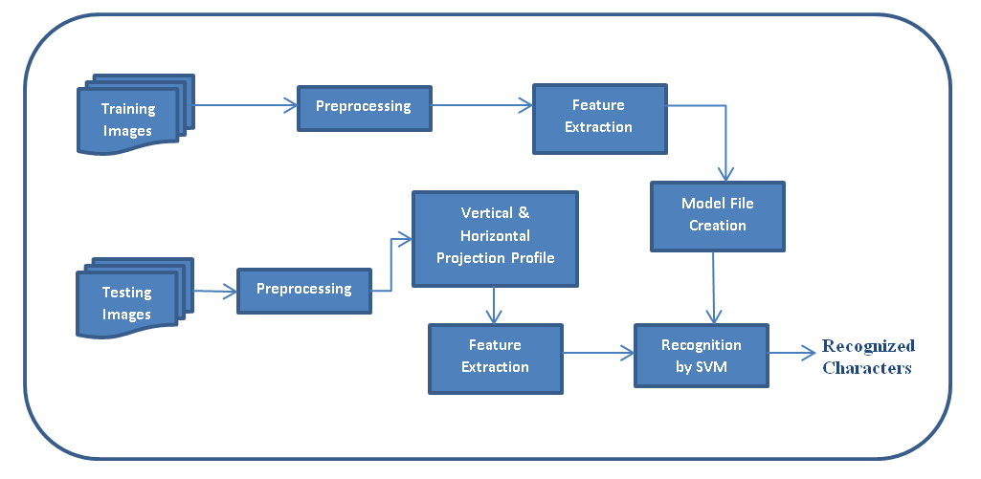
Components of Neural Networks
Pre-processing is used to discard irrelevant information in the input data, to increase the speed and accuracy.
It consists of binarization, normalization, sampling, smoothing and denoising.
Text localization is done using region extractor.
Features are extracted from the localized regions.
Apply classification algorithms to recognize the input.

Slide 10
Histogram of Oriented Gradients
Global image normalisation – Reduce local shadowing and illumination variation proportional to image texture strength.
Computing the gradient image in x and y - Capture contour, outline and texture information while providing resistance to illumination variations.
Computing gradient histograms - Produce encoding sensitive to local image content while remaining resistant to changes in appearance. The image window is divided into cells and we accumulate a local 1-D histogram of gradient for all the pixels in each cell.
Normalising across blocks - Takes group of cells and contrast normalise overall responses for better invariance to illumination, shadowing, and edge contrast.
Flattening into a feature vector - Collects the HOG descriptors from all blocks into a combined feature vector.

Slide 11
Support Vector Machine
SVM is a supervised machine learning algorithm used for both classification or regression challenges.
Plot each data item as a point in n-dimensional space (n-number of features) with the value of each feature being the value of a particular coordinate.
Perform classification by finding the hyper-plane that differentiate the two classes.
In Python, scikit-learn is the library used for implementing machine learning algorithms.

Slide 12
Pros and Cons associated with SVM
Pros:
Works well with clear margin of separation.
Effective in high dimensional spaces.
Effective in cases where number of dimensions is greater than the number of samples.
Uses support vectors in the decision function, so it is also memory efficient.
Cons:
Doesn’t perform well, when we have large data set as the training time is higher
Doesn’t perform well, when the data set has more noise i.e. target classes are overlapping
SVM doesn’t directly provide probability estimates, these are calculated using an expensive five-fold cross-validation.

Slide 13
Assumption during testing
Digits should be sufficiently apart. Otherwise they will interfere in the square region around each digit.
In most real world images, fixed thresholding does not produce good results. So, we need to use adaptive thresholding.
In pre-processing we did Gaussian blurring. We need to open and close the image to remove small noise pixels and fill small holes.

Slide 14
Applications
Users can able to convert the surveys, contracts, invoices, receipts, into electronically manageable files.
It makes the old age books into e-books. So we can read those books online too.
In libraries and offices the documents are scanned periodically for backup and archival

Slide 15
Future Work
Training and recognition speeds can be increased greater and greater by making it more user-friendly.
To train tesseract for new text fonts through transfer learning on LSTM models in order to improve accuracy.
Reading handwriting is a very difficult task considering the diversities that exist in ordinary penmanship. However, progress is being made.

